Slide 1
Introduction

Slide 2
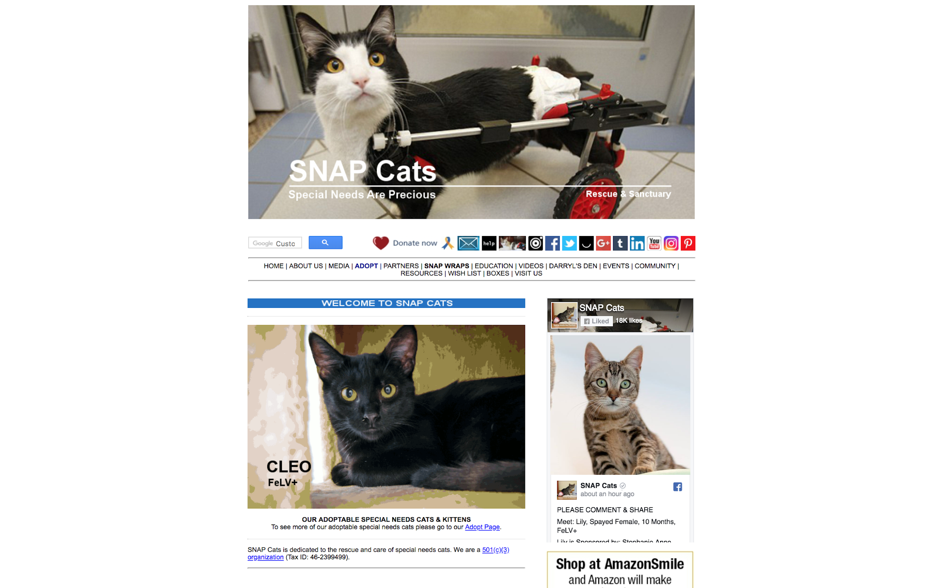
Original Site

Slide 3
Schedule & Milestones

Slide 4
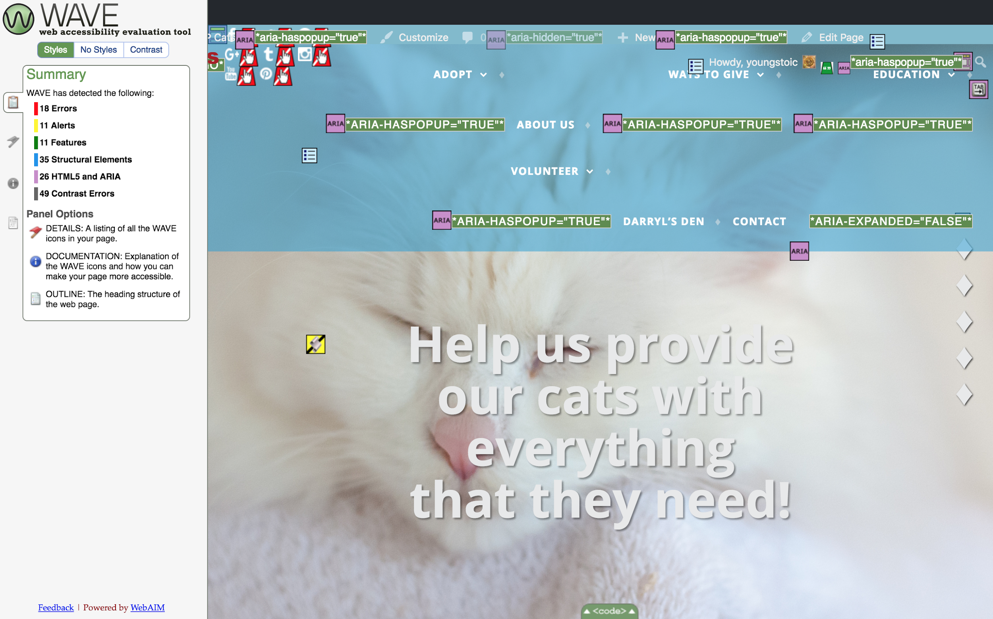
Accessibility / SEO

Slide 5
Team Working Process

Slide 6
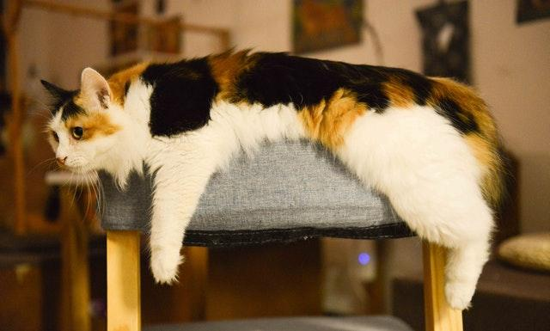
Site Audiences
Users
Potential cat adopters
Volunteers
Donors
Users who already own or are interested in learning about special needs cats
Age Range
Young adult to seniors
Notes:
Site Audiences
The four site audiences for SNAP Cats are cat adopters, volunteers, donors and individuals interested in learning about special needs cats. Age ranges span from young adults to seniors. Our client emphasized that many individuals who interact with his site are older.

Slide 7
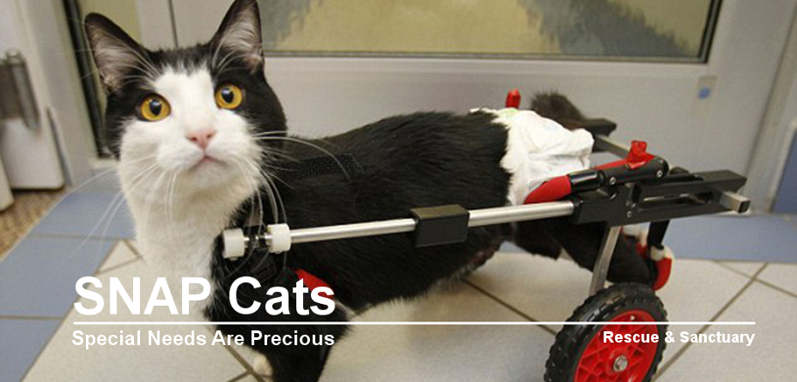


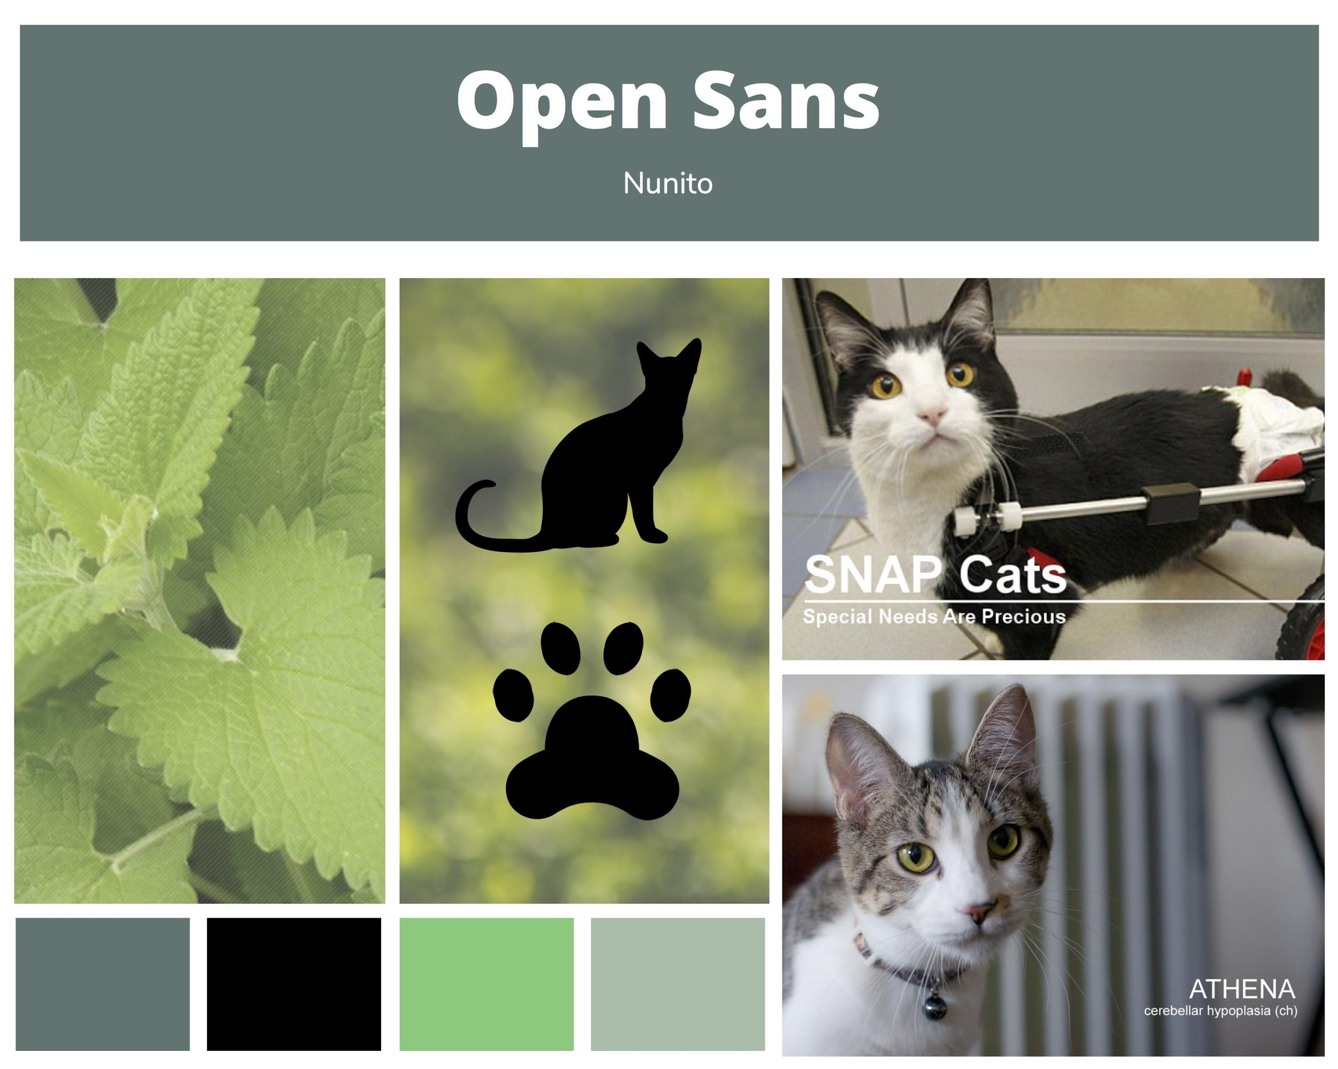
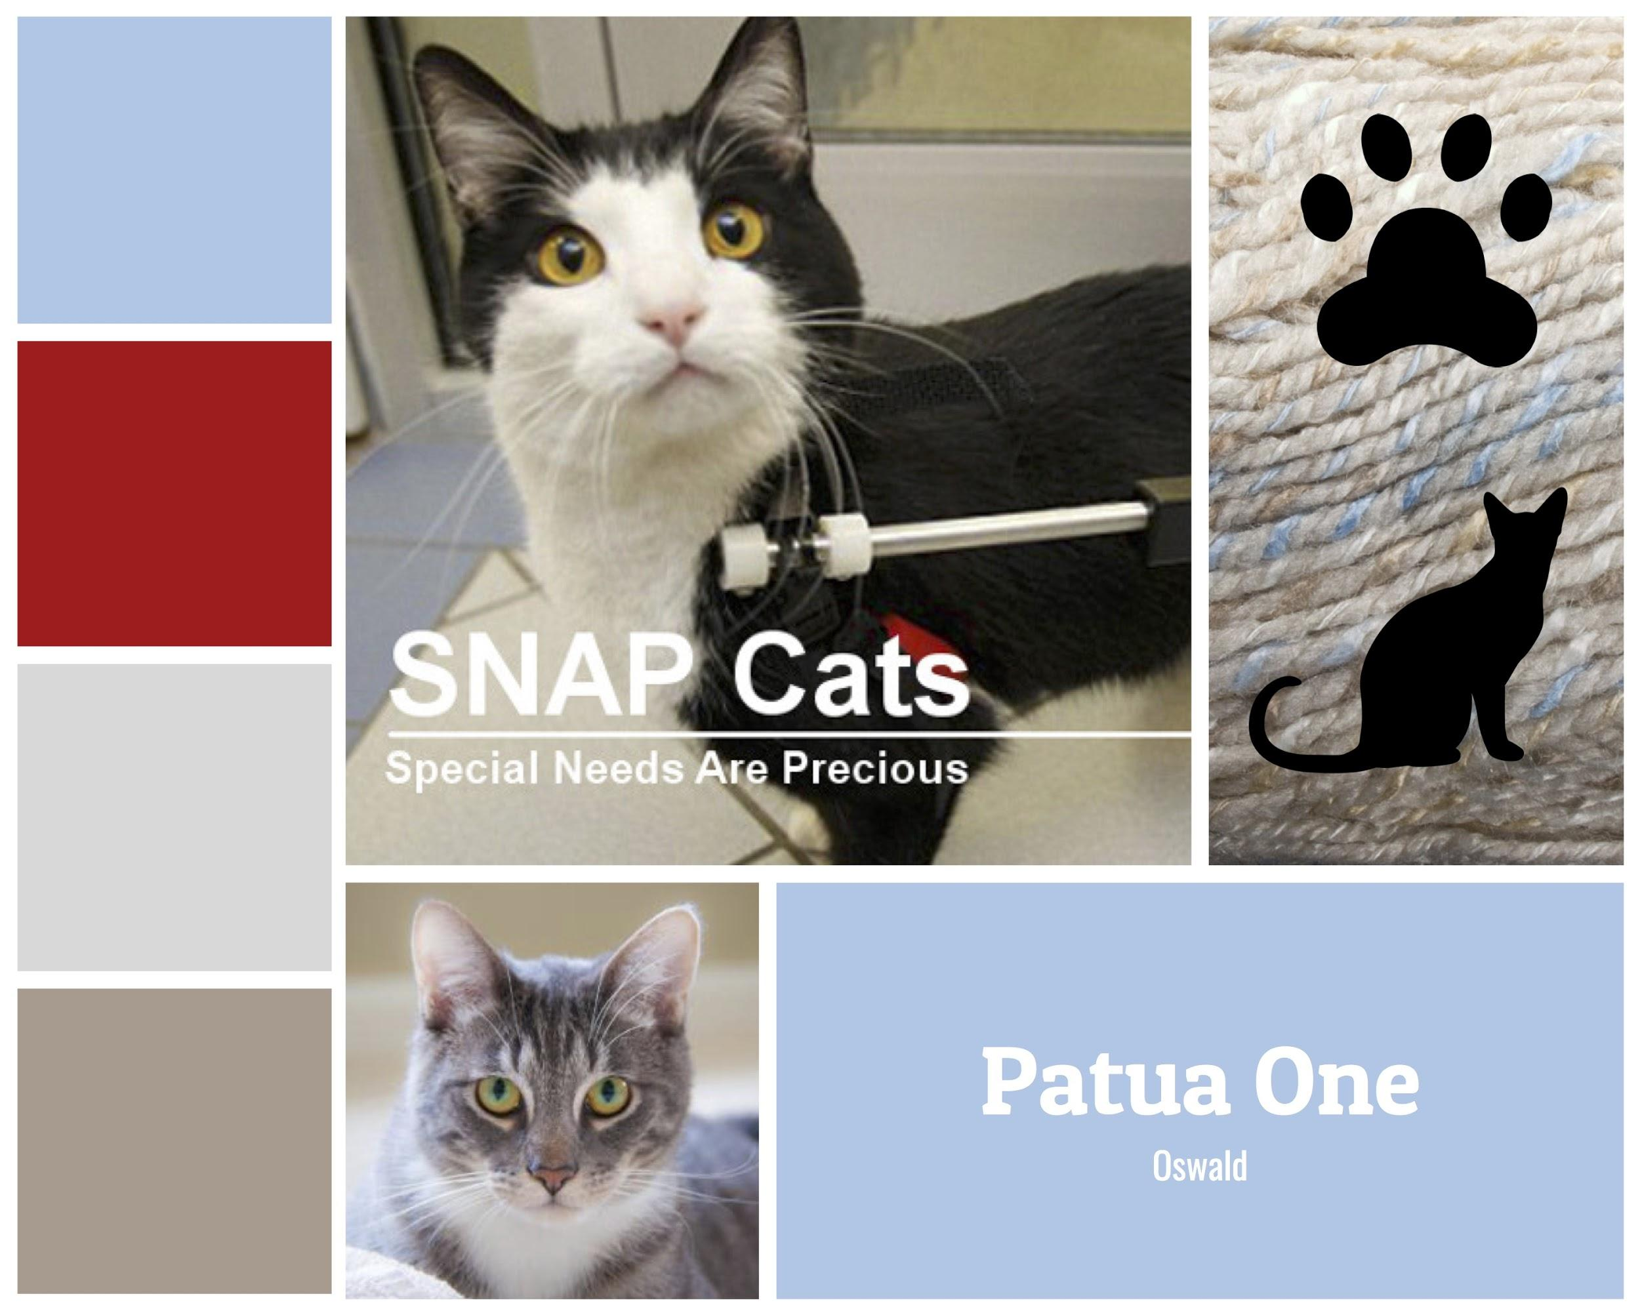
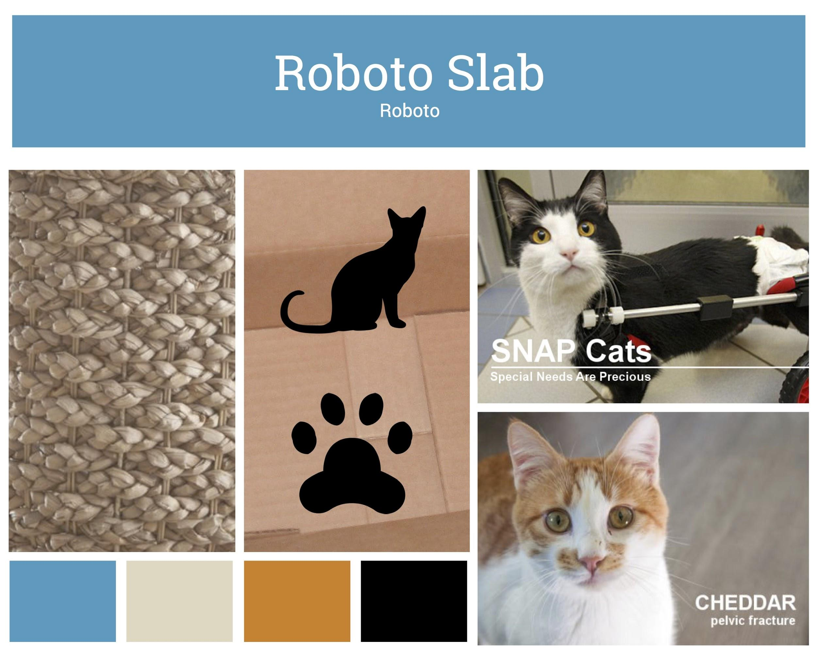
Logo Design and Moodboards
Notes:
Logo Design and Moodboards
Originally, there was a photo used in place of a standard logo on the website and a standard logo that was used on merchandise. The textile format didn’t translate into any of the Adobe programs, so I was tasked with recreating the logo. Josh got rid of the white background in Photoshop and I remade the logo in Illustrator. It went through several iterations. The final logo is a doctored image that our client sent back (the cat portion of the logo with red, Arial type) that Evalyn cleaned up in GIMP.
I designed three different sets of colors and typefaces (shown here) based on a few guidelines from the client.

Slide 8
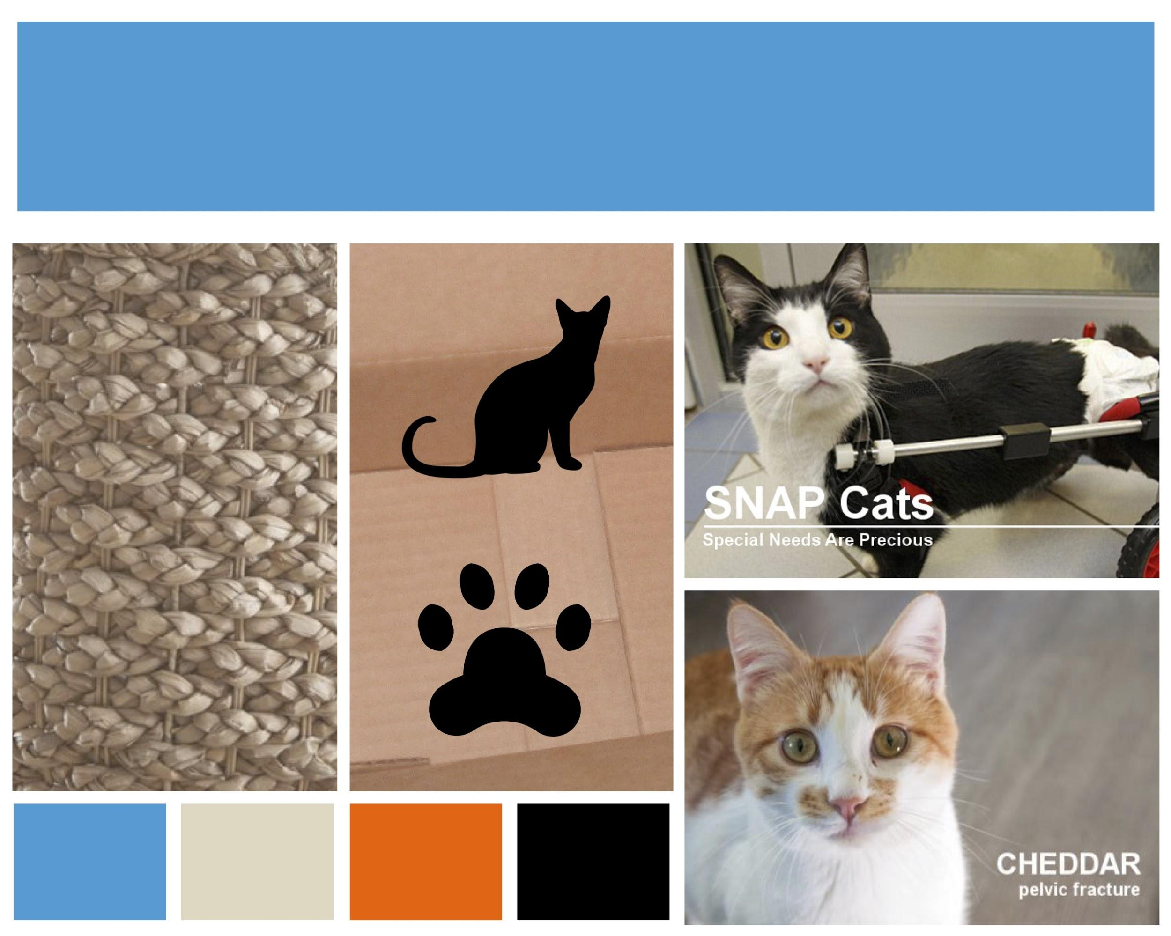
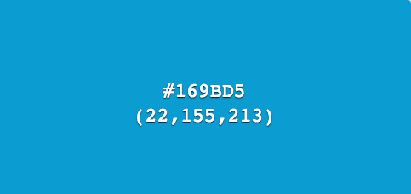
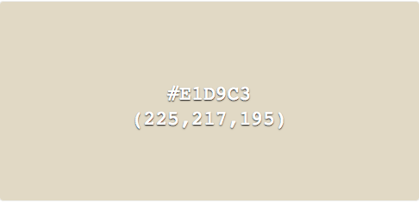
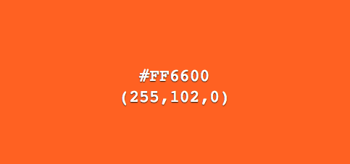
Color Palette & Typography
Open Sans
Nunito
Notes:
Color Palette and Typography
Our client expressed interest in warm, blue and pastel colors, and liked modern sans-serif typefaces, so I took this into account when designing. The client chose Open Sans and Nunito and this palette. The complimentary colors work well and it has an energetic presence due to highlights of bright orange throughout the website.

Slide 9
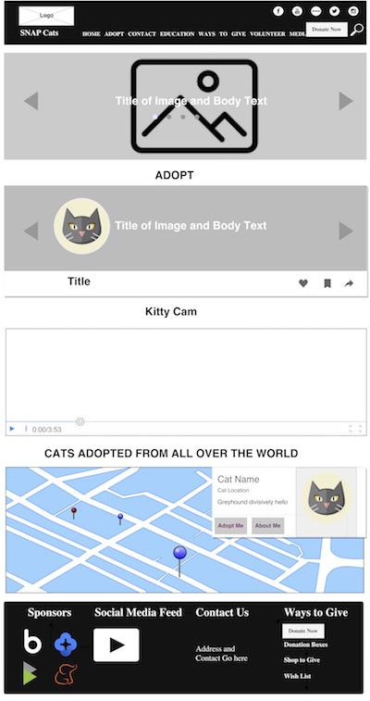
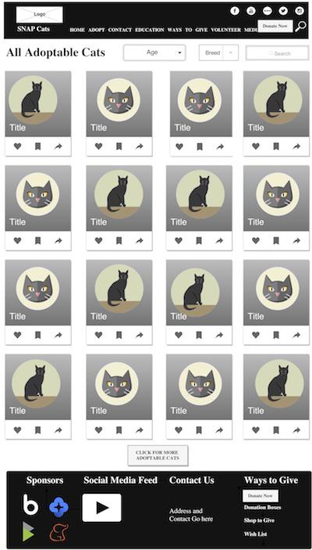
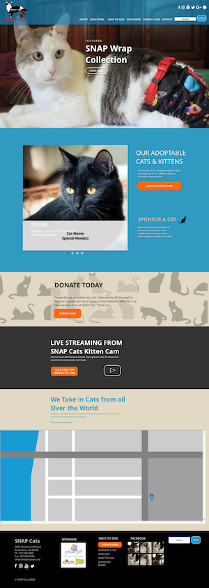
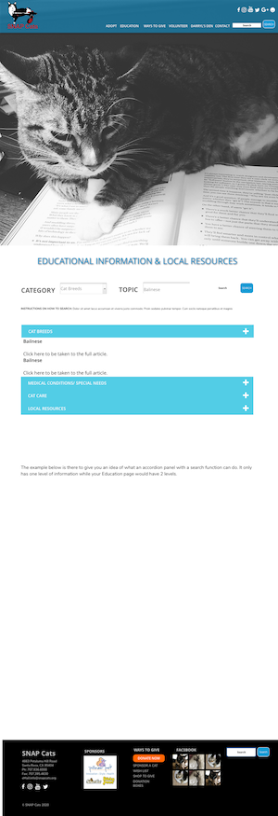
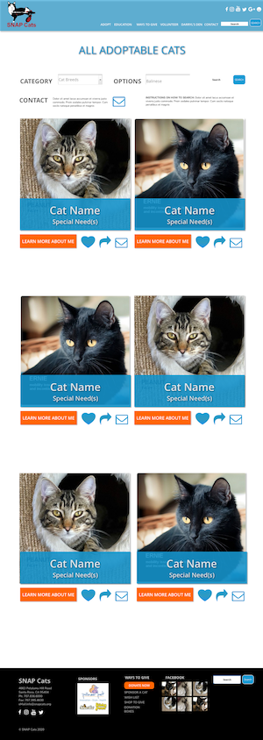
Wireframes to Mockups
Notes:
Wireframes to Mockups
I used Draw IO to create wireframes and then Axure to create interactive mockups of 4 distinct layouts. I had wanted a seamless process from mock-up to final site, but this was not the case due to template and feature customization and different categorization methods in Axure. However, I do feel that it was helpful in illustrating general site flow and basic design elements to our client.

Slide 10
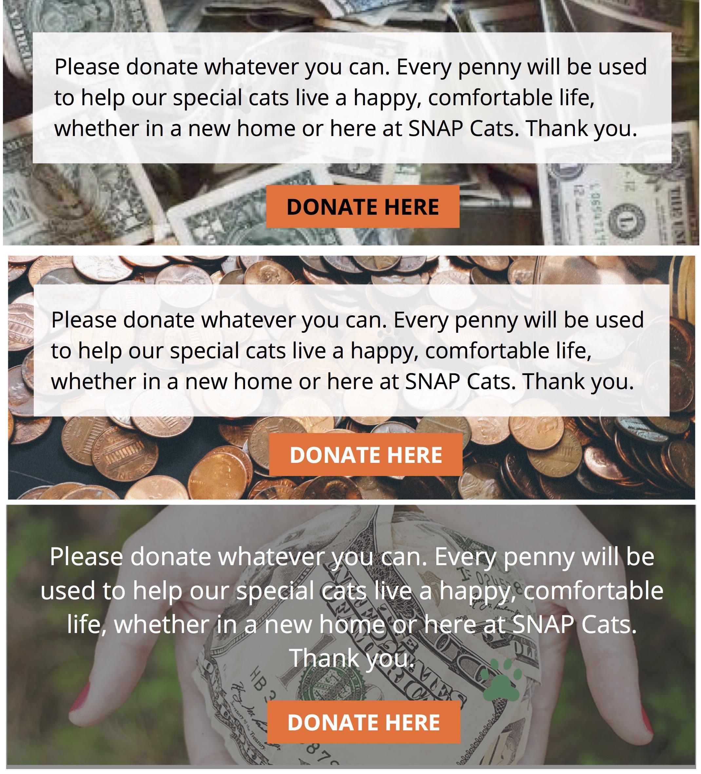



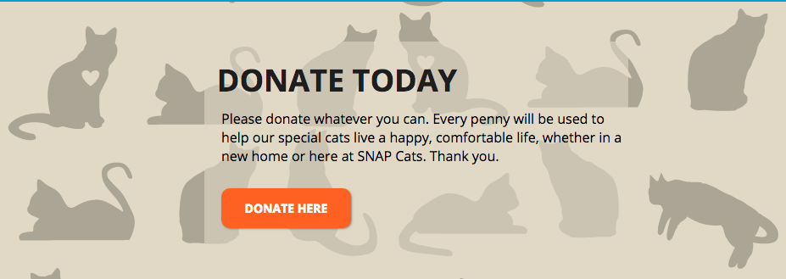
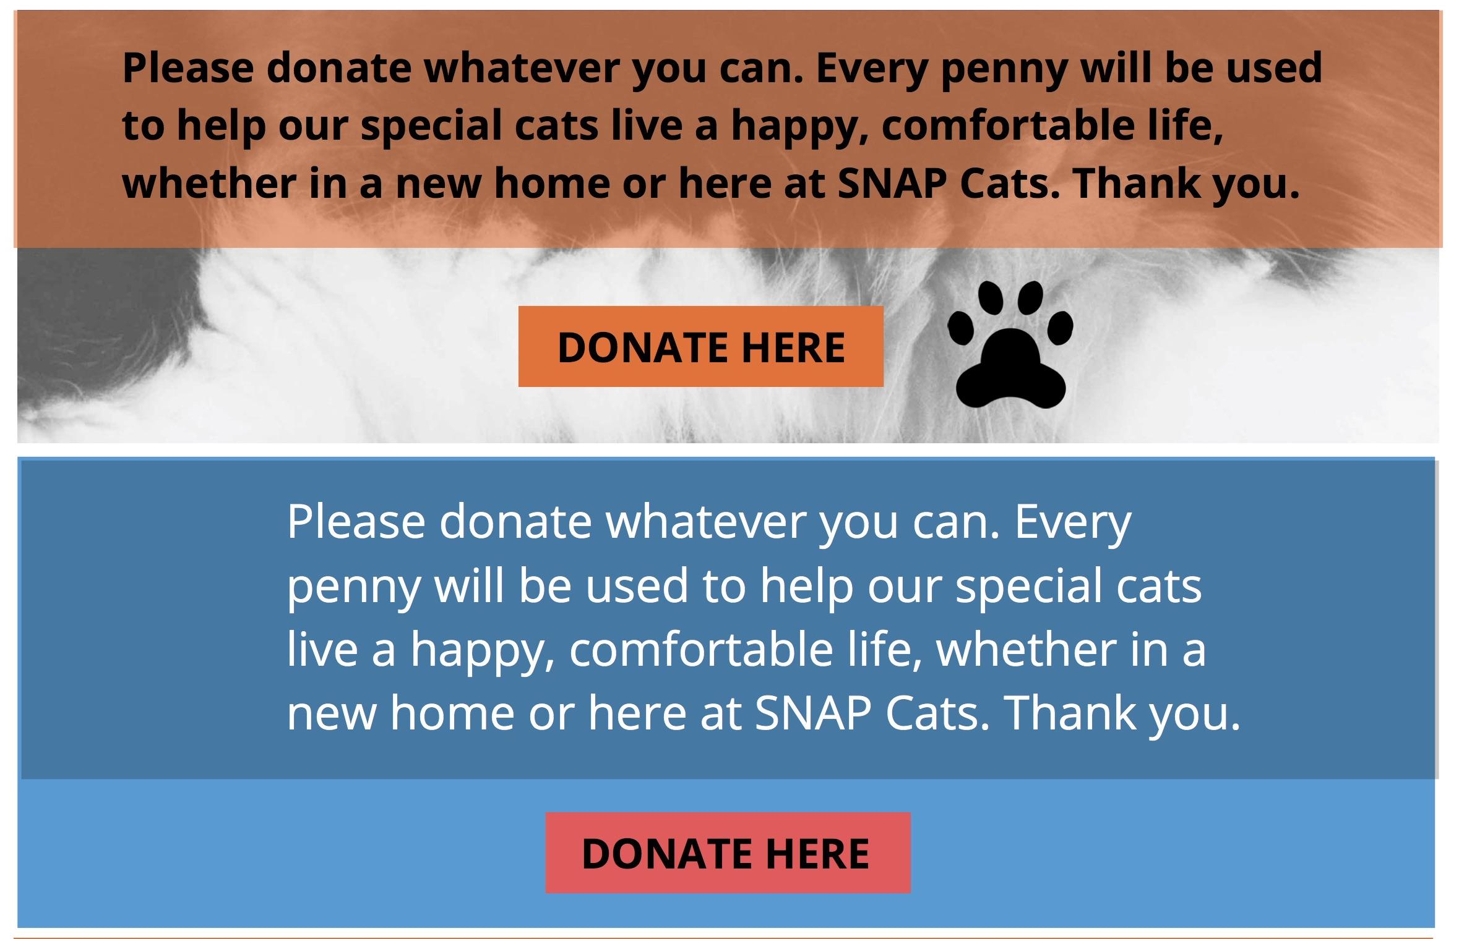
Design
Notes:
Design
Overall I think the design of the site looks a lot like the prototype, however due to time constraints and the limitations of our template, some elements were not possible. Here are some design “bloopers” that didn’t make it into the site.

Slide 11
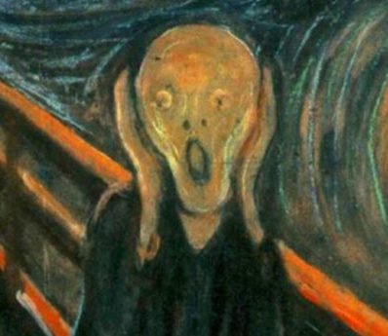
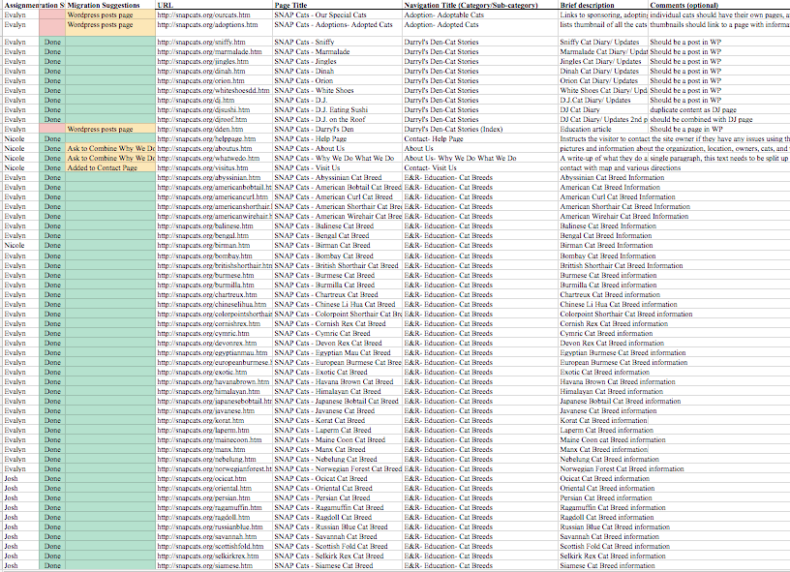
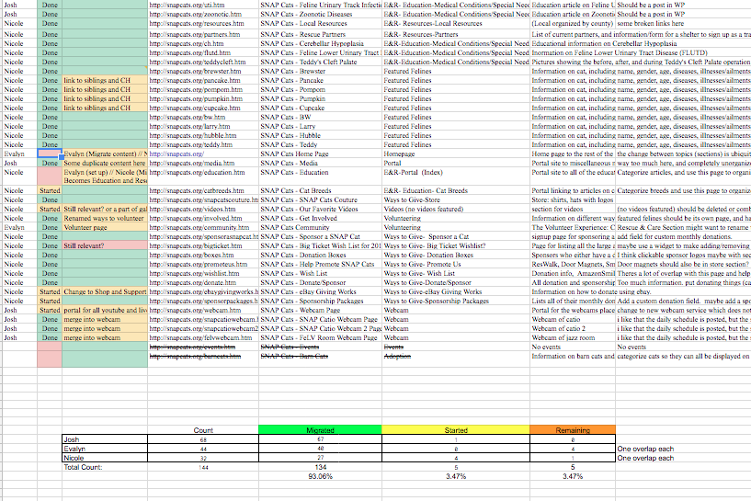
Content Migration
144 pages split between 3
Breakdown:
Josh - 47%
Evalyn - 30%
Nicole -22%
Notes:
Content Migration
Our group had the most web pages overall and had the fewest teammates, so we knew that it would be an undertaking. Evalyn did our content audit and started our categories, which I refined later. The approximate migration breakdown is the following: Josh took on 47%, Evalyn did 33% and I was responsible for 22%. Since the original site was hand-coded in HTML without CSS, we were able to transfer much of it over as it was or use a basic code cleaner for more complicated elements.

Slide 12
Content Management System
Notes:
Content Management System -- Evalyn

Slide 13
Site Map or Info Architecture
Notes:
Site Map or Info Architecture -- Evalyn

Slide 14
Responsive / Mobile
Notes:
Responsive / Mobile -- Evalyn

Slide 15
Site Feature #1 ( RescueGroups API )
Notes:
Site Feature #1 ( RescueGroups API ) -- Evalyn

Slide 16
Site Feature #2 ( WordPress Theme )
Notes:
Site Feature #2 ( WordPress Theme ) -- Evalyn

Slide 17
Site Feature #3 ( GoogleMaps API )
Notes:
Site Feature #3 ( GoogleMaps API ) -- Evalyn

Slide 18
Site Feature #4 ( )
Notes:
Site Feature #4 ( ) -- Joshua

Slide 19
Conclusion
Notes:
Conclusion -- Joshua, Nicole, & Evalyn

